Slide 1
College Councils Recruitment
Micah Remedios
Director of New College Council Development

Slide 2
Why Recruitment?
You are the brand of the knights of Columbus on your College Campus – Supreme knight Carl Anderson

Slide 3
What is a college council
Is a Knights of Columbus unit formed at a college or university to meet the needs of students and their campus community
In a unique way our councils create an environment for Catholic men to discern their vocation and become the best version of themselves.
Supported by other men who share their faith and passion for service, fraternity, and socialization,

Slide 4
College Councils - Faith in Action
Faith
Marian Prayer
Rosary Program
Holy Hour
Family
Food for Families
Keep Crist in Christmas
Movie program
Dinner & discussion
Community
Coats for Kids
Global Wheelchair Mission
Habitat for Humanity
Free throw Championship
Life
March for Life
Special Olympics
Ultrasound Program

Slide 5
Common Objections to Membership
Not enough time
No required time commitment
Schedule may change down the road, can become more involved then
I don’t know enough about the Knights
Create an elevator pitch about the Knights and your council
Just for old guys
Well, clearly not…
150 college councils in North America, 5,000 college Knights

Slide 6
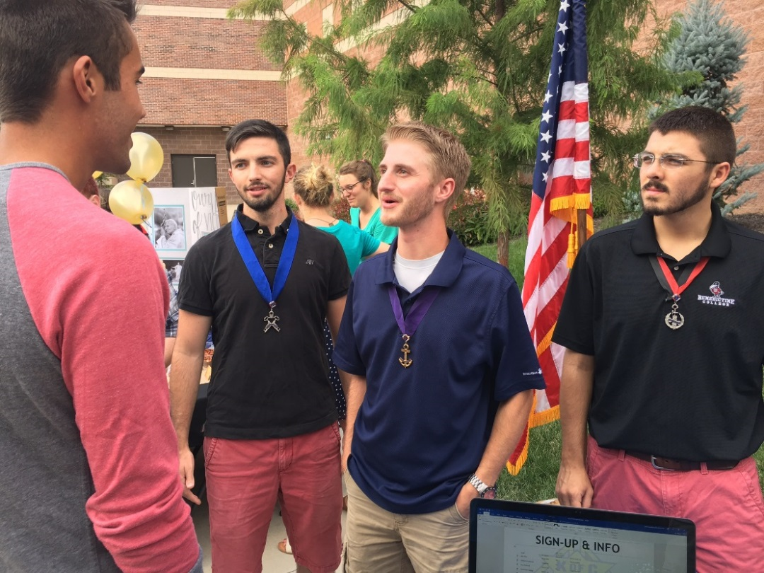
How you can help
Identify
Graduating members from the Squires programs or in University.
Active men from the age of 19-35
Meet
Meet with each graduating member to discuss options of joining and forming a group
Establishing
University Contacts to pass them on to us

Slide 7
What we need to form a new council
Have 20 active men to take a first degree or transfer in
Hold an Election of Officers
Appoint a Chaplain
Appoint a Financial secretary (cannot be a student)

Slide 8
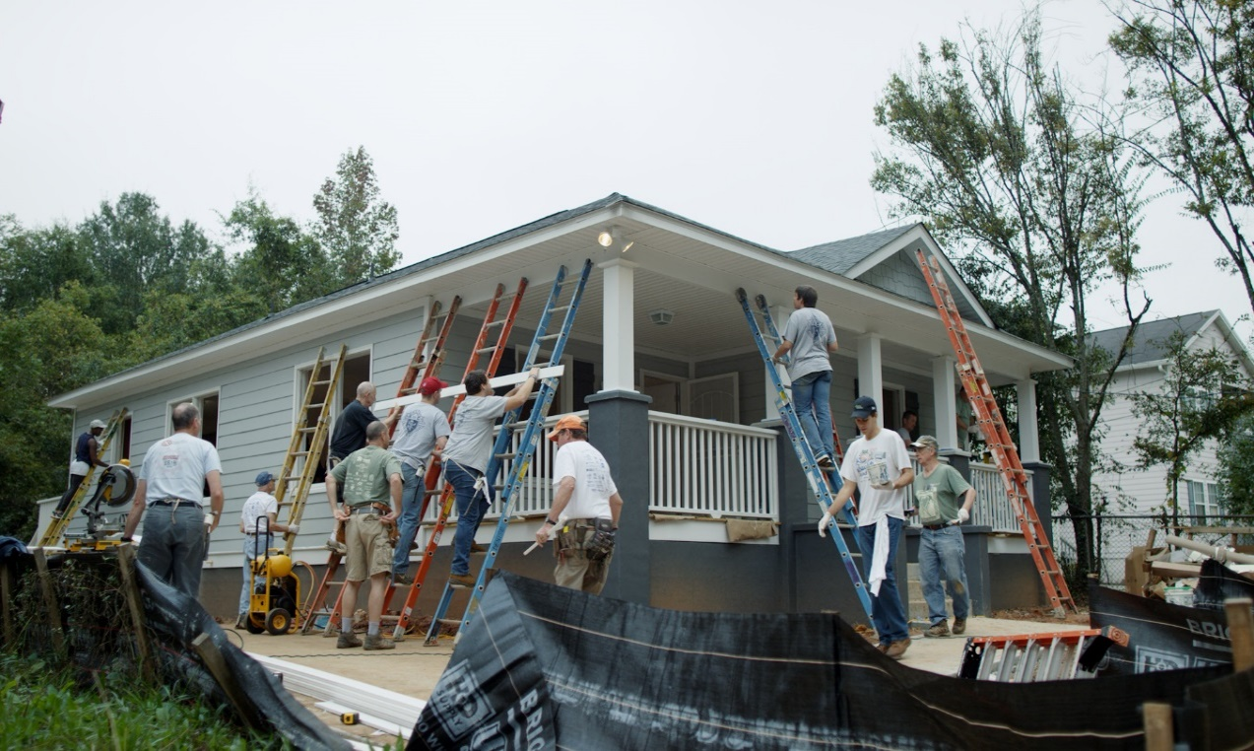
How is it beneficial
Creates leaders
Bring young men towards the faith
Forms lasting friendships
Networks with peers
Access to the Life Insurance portfolio

Slide 9
How it can help you
Helps the community
Assist your District and the councils
Strengths your membership retention
Grows your membership
Entry point into the Knights of Columbus

Slide 10
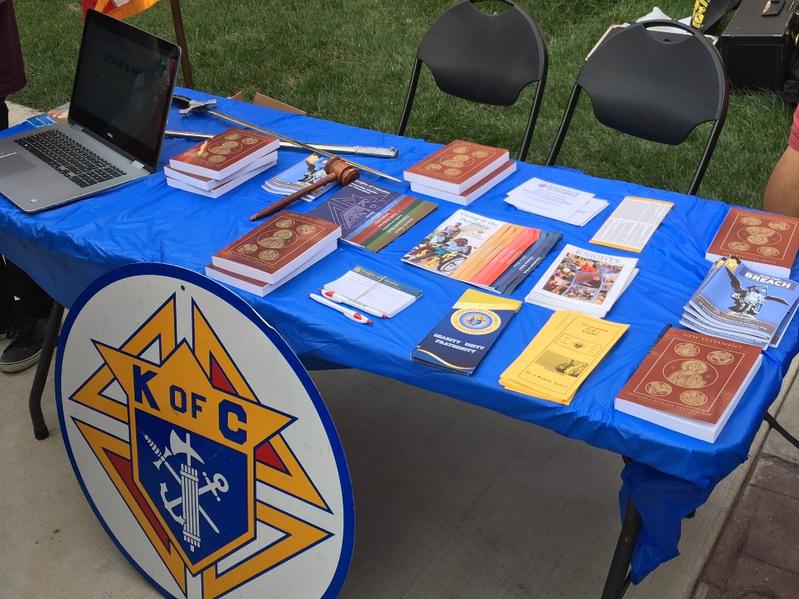
Incentives

Slide 12
Youth are the future

Slide 13
Questions
Micah Remedios
E: micah.remedios@me.com
P:647-456-3192

